Slide 1


Hotel Reservation Analysis
Presented By Ashish Mishra
Mentorness Batch: MIP-DA-04

Slide 2

Project Overview
Data is very much essential to the hotel sector in order to make well-informed decisions and improve the overall visitor experience. In this project, we have to examine a large dataset of hotel reservations in order to derive important insights. Our objectives is to determine visitor preferences, spot patterns in booking behavior, and identify critical elements that impacts the hotel's operations..

Slide 3


Objective:
Our goal is to use SQL for comprehensive dataset exploration and analysis. Its main motive is to uncover patterns through the dataset's specialized queries, which will inform us the strategic choices and maximize the hotel's overall performance.
TOOLS USED:

Slide 4
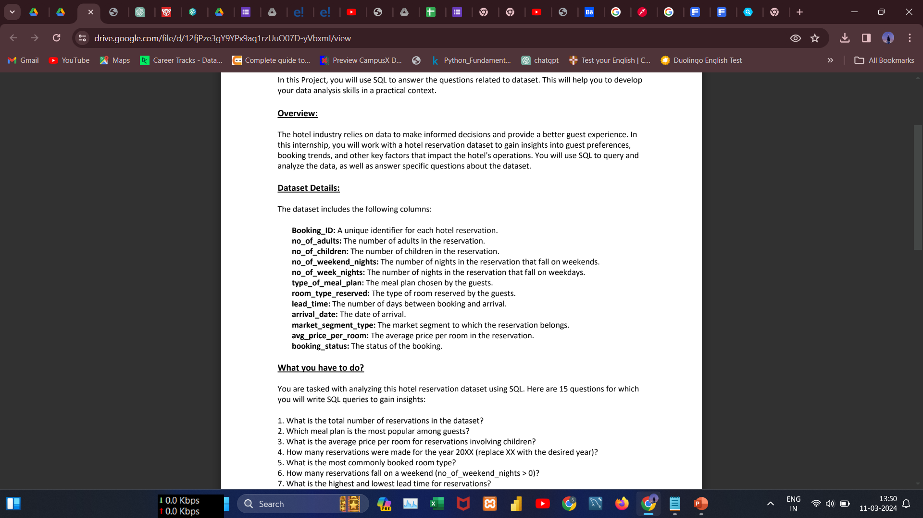
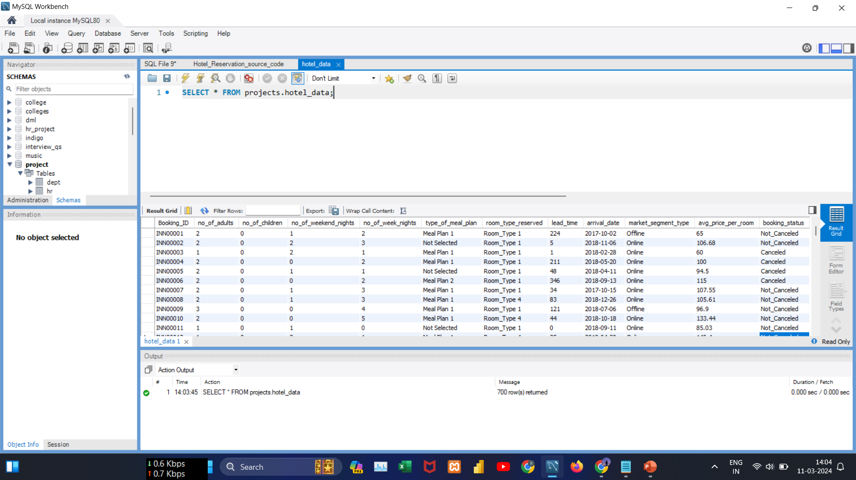
Dataset Overview

Slide 5
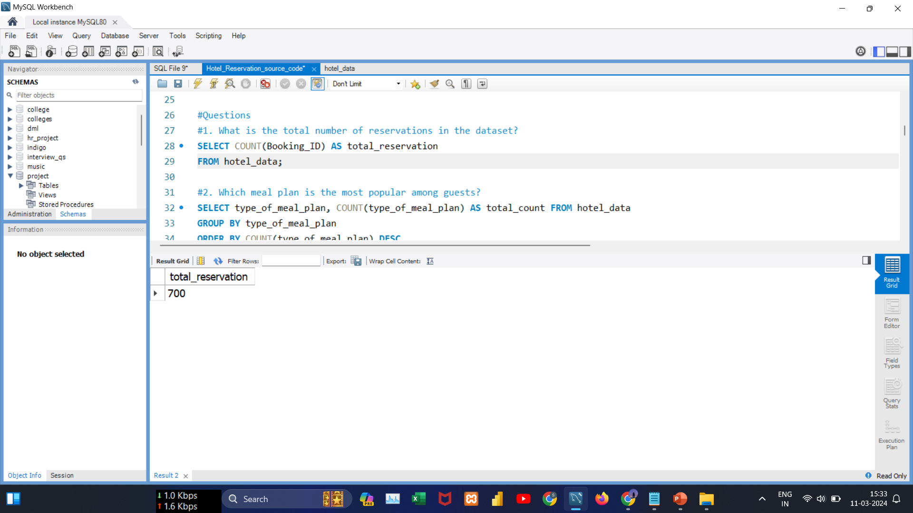
Data Analysis Queries
#Query1 :
What is the total number of reservations in the dataset?
Insights:
There are 700 reservations in the dataset.

Slide 6
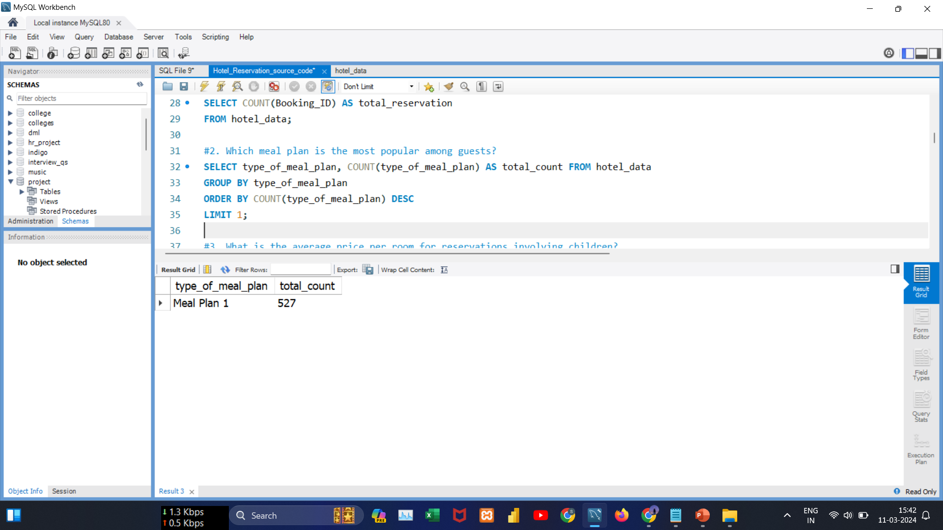
Data Analysis Queries
#Query2 :
Which meal plan is the most popular among guests?
Insights:
Meal Plan 1 stands out as the most popular choice among guests.

Slide 7
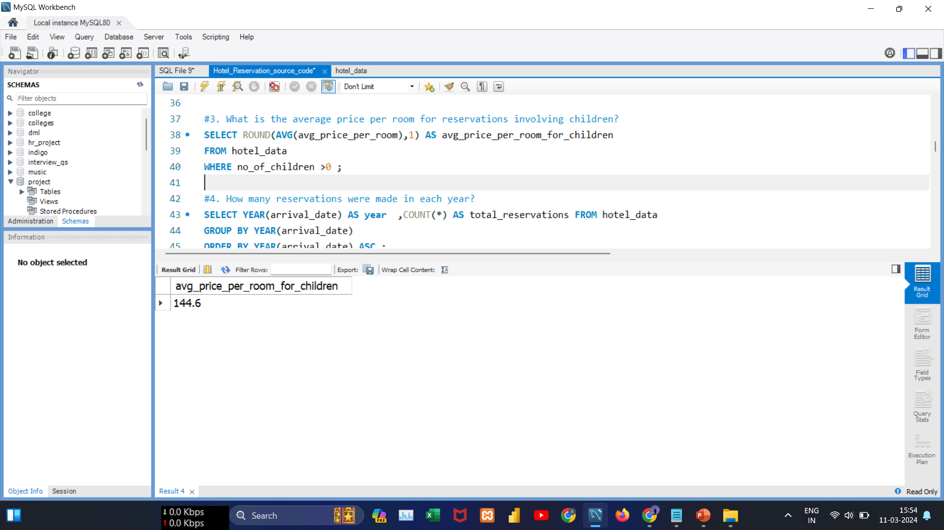
Data Analysis Queries
#Query3:
What is the average price per room for reservations involving children?
Insights:
Reservations involving children have an average room price of 144.6.

Slide 8
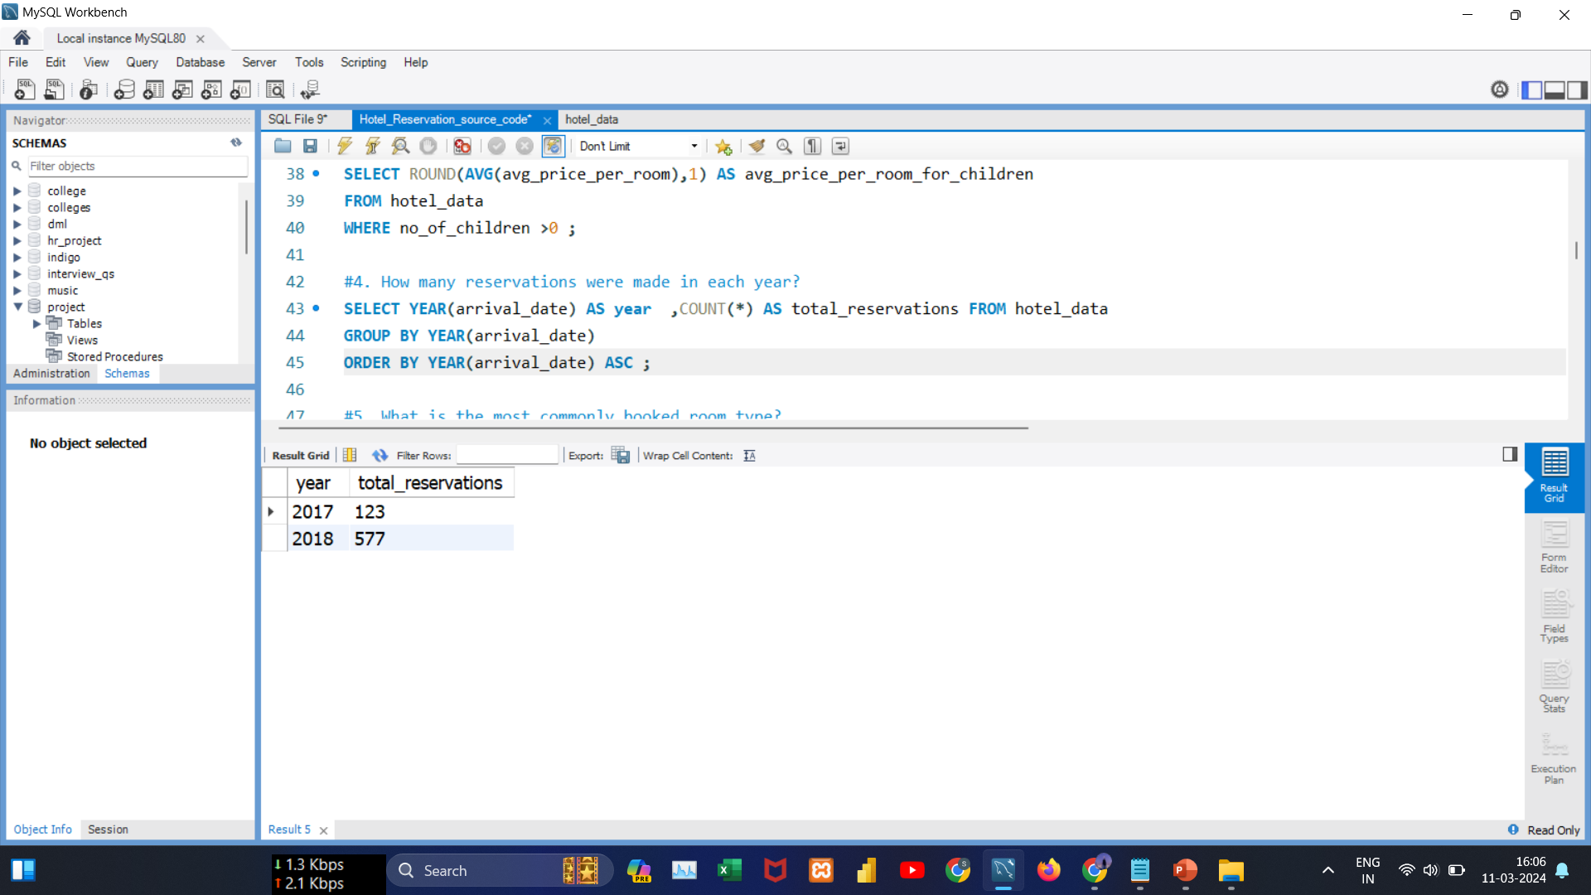
Data Analysis Queries
#Query4:
How many reservations were made in each year?
Insights:
In 2017, there were 123 reservations. Also, in 2018, the reservations experienced a significant increase that clearly indicates the positive growth.

Slide 9
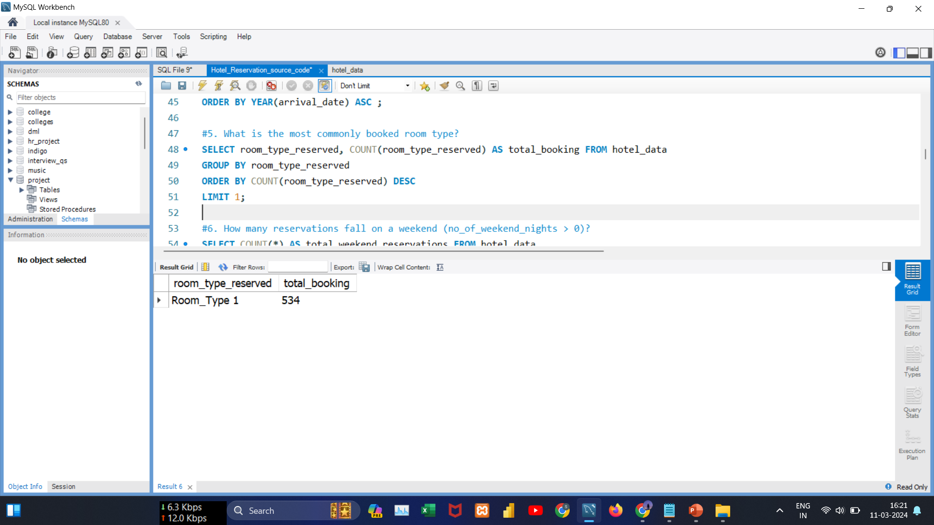
Data Analysis Queries
#Query5:
What is the most commonly booked room type?
Insights: The Room_Type 1 Is the guests' top choice for bookings.

Slide 10
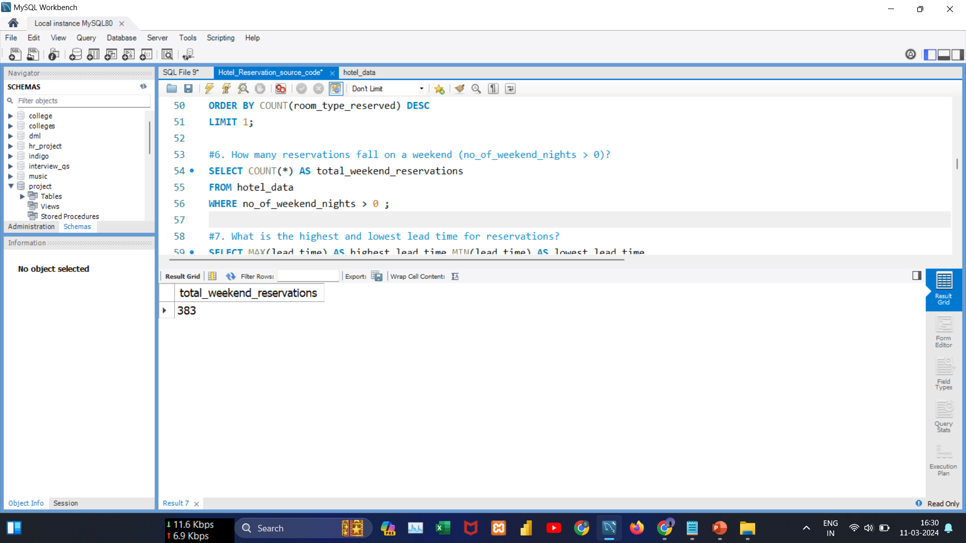
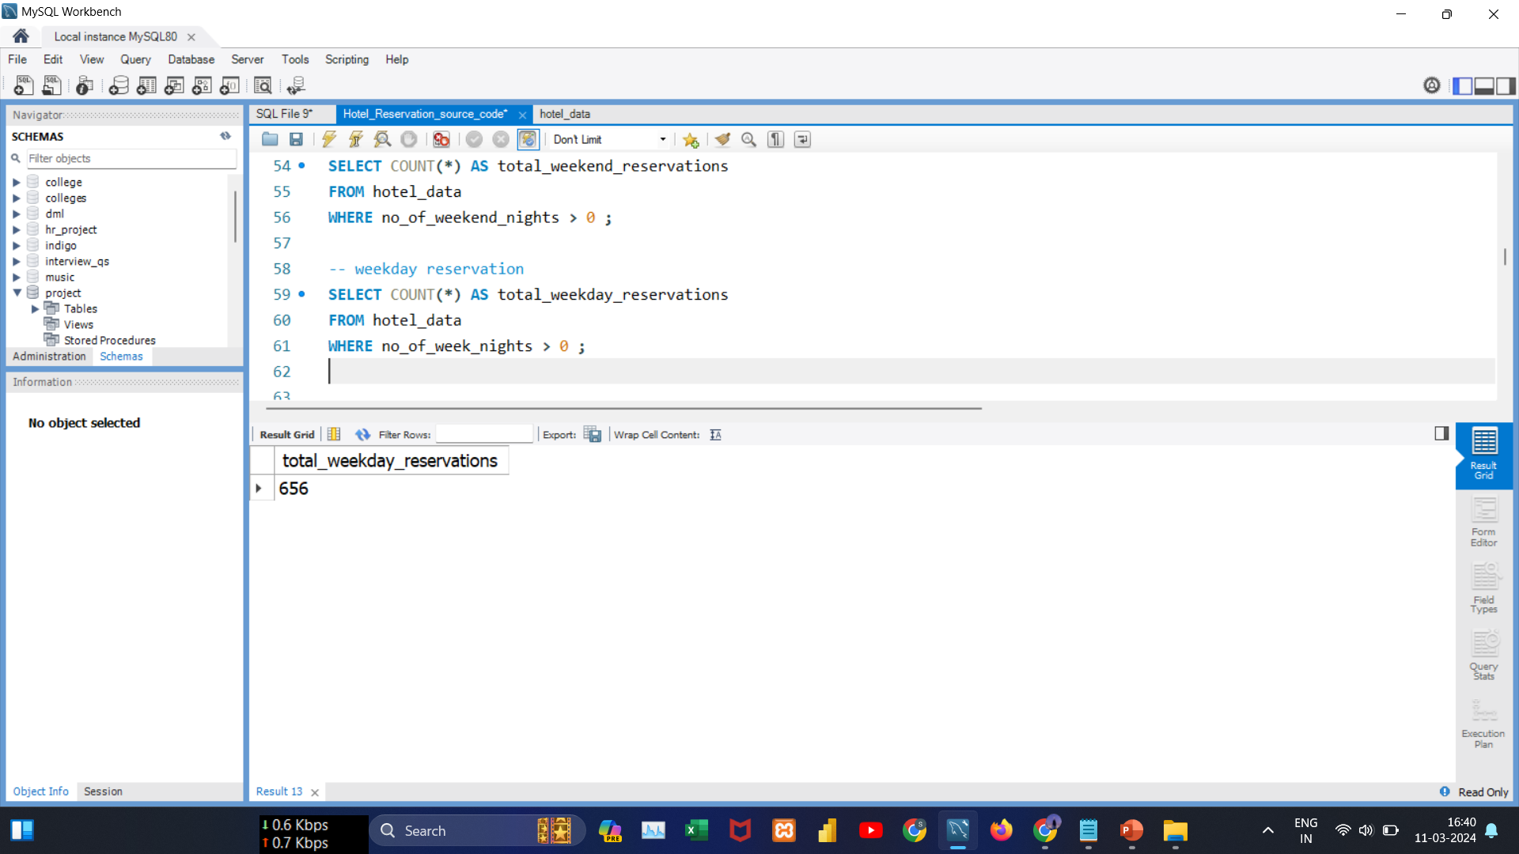
Data Analysis Queries
#Query6:
How do guest reservations vary between weekend and weekday nights?
Insights: There is higher number of reservations for weekday nights (656) as compared to weekend nights (383) that suggests a guest preference for staying during weekdays.

Slide 11
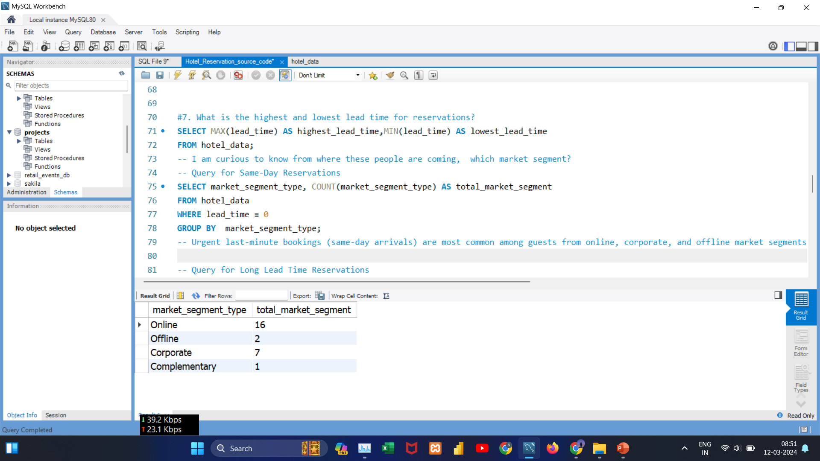
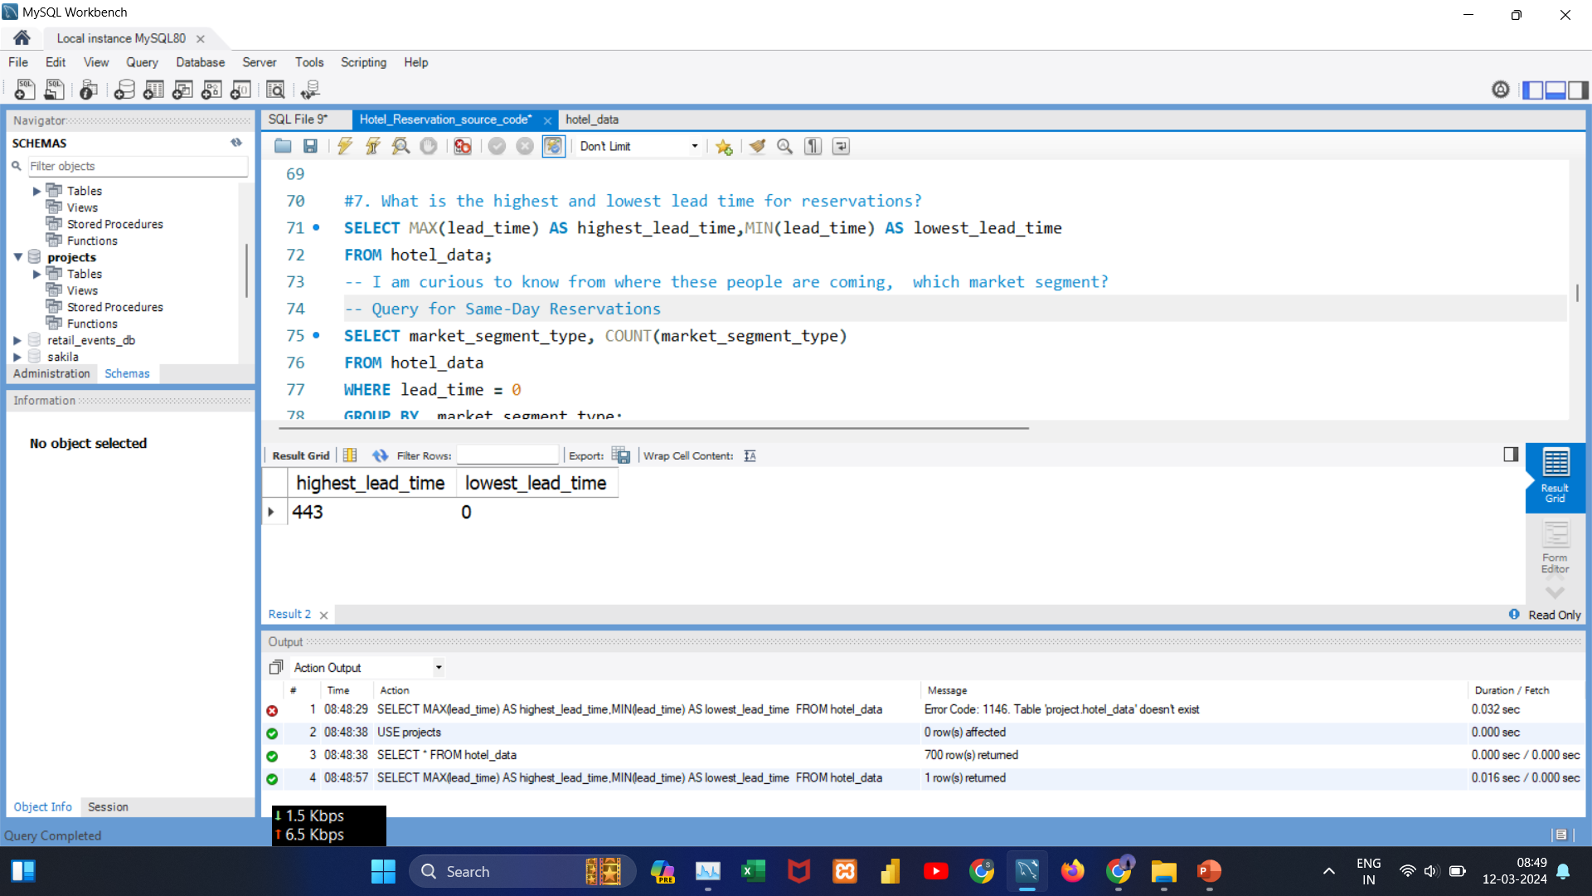
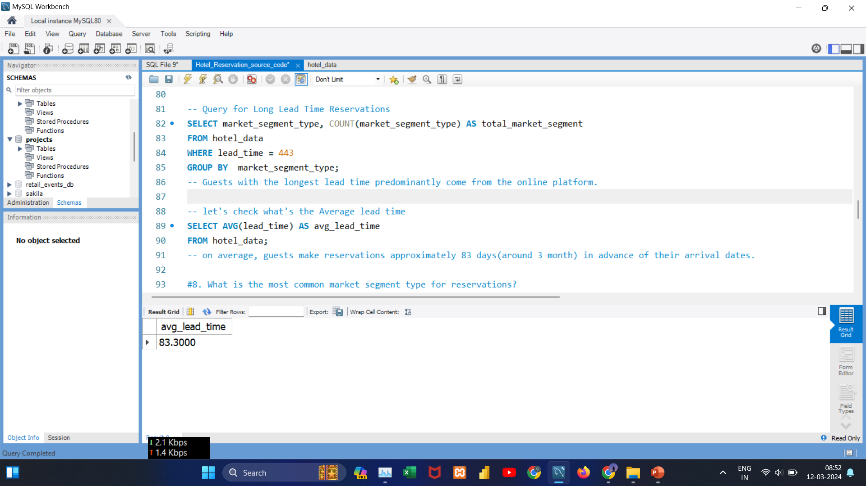
Data Analysis Queries
#Query7:
What is the highest, lowest, and average lead time for reservations?
Insights: The range of lead times, from 0 to 443 days, suggests diverse booking behaviors among guests. Some prefer last-minute reservations, while others plan well in advance. On average, the reservations have a lead time of 83.30 days.

Slide 12
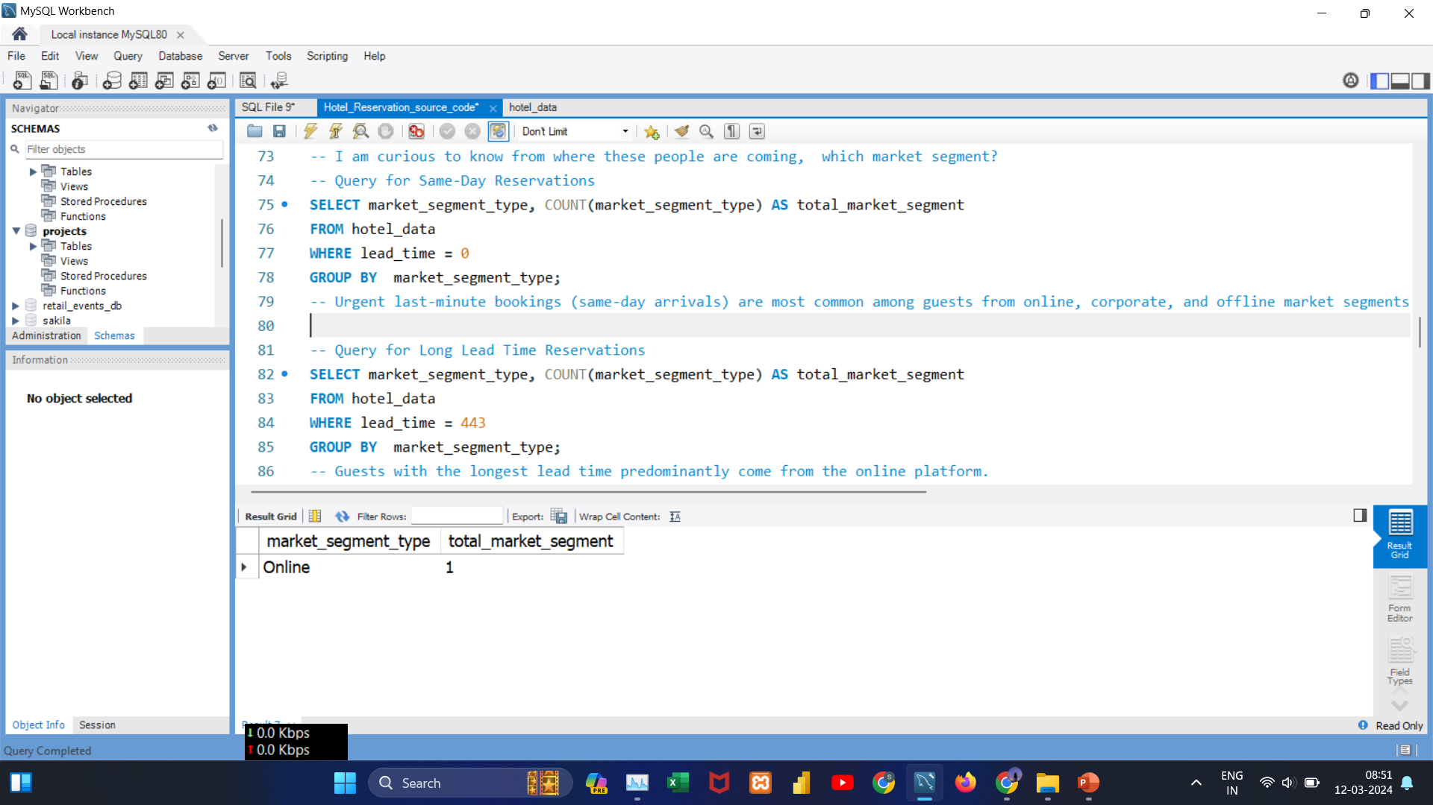
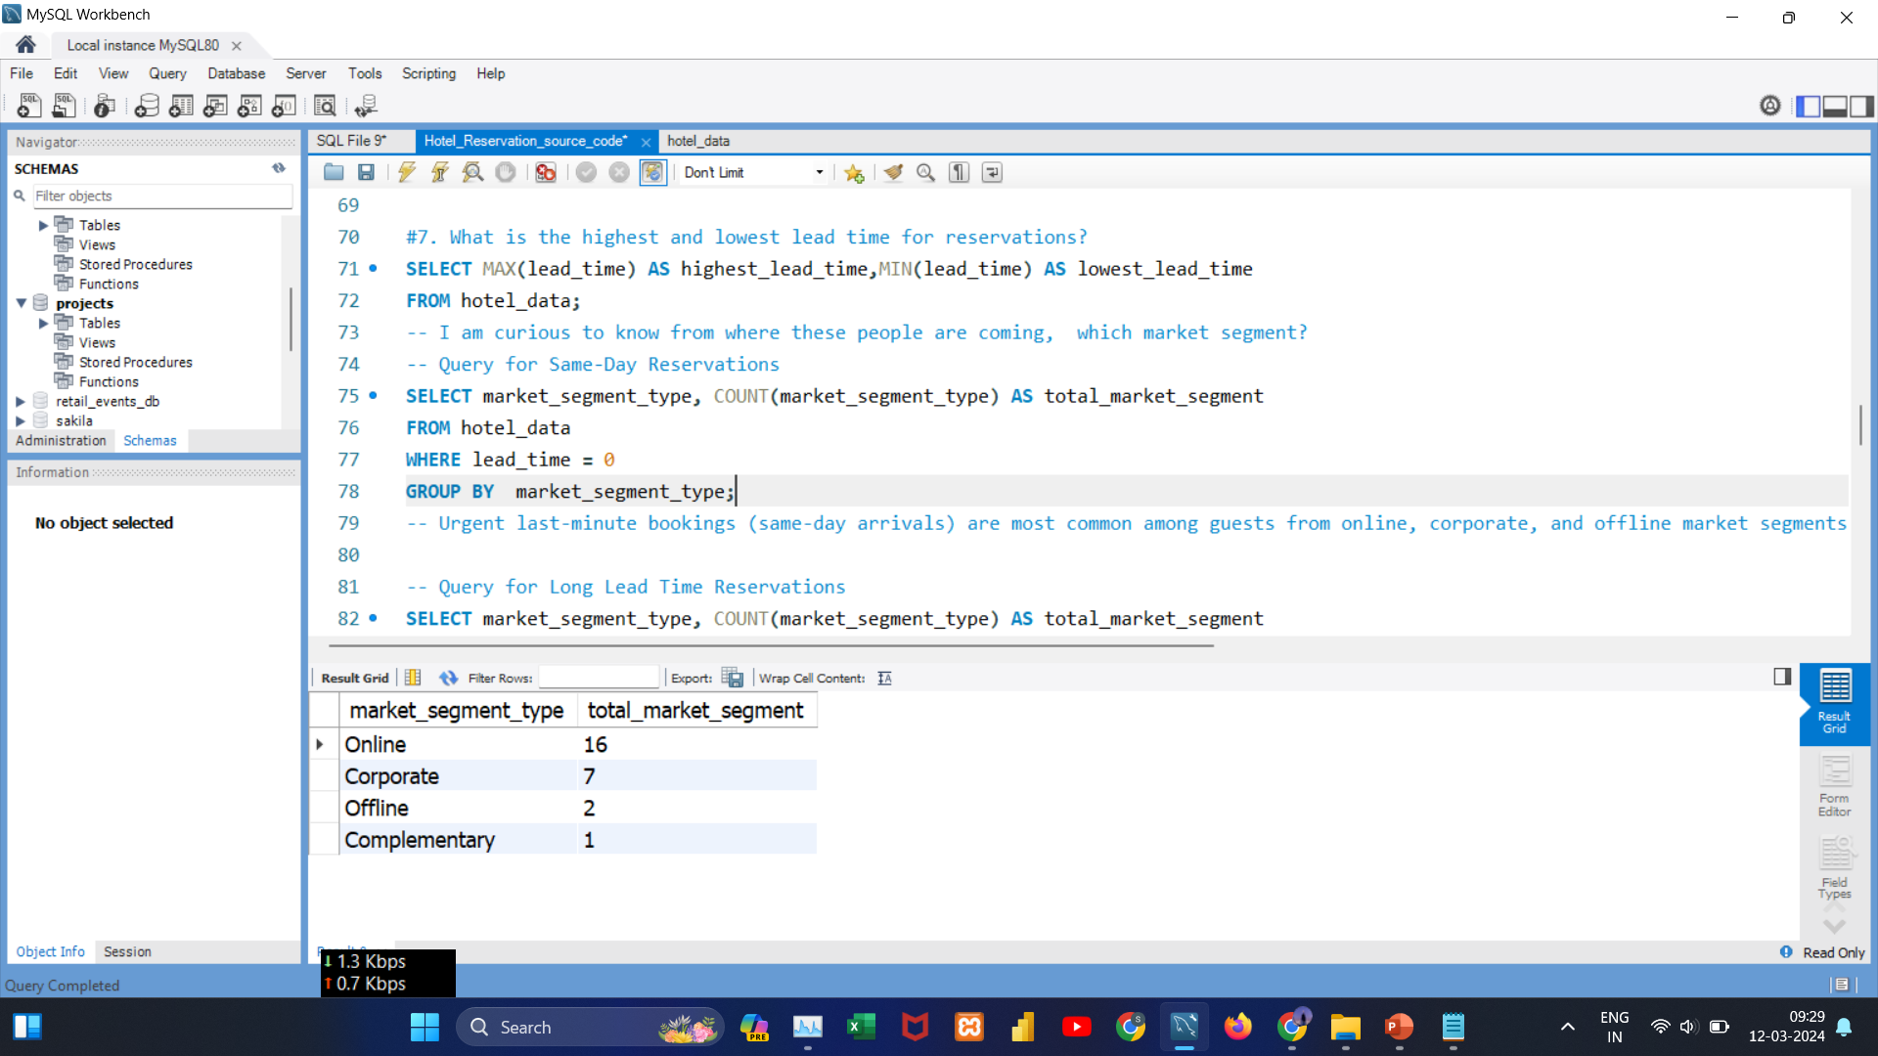
Data Analysis Queries
#Query8:
What is the distribution of market segments for guests making same-day reservations versus those with long lead times (443 days)?
Insights:
Urgent last-minute bookings (same-day arrivals) are most common among guests from online, corporate, and offline market segments.

Slide 13
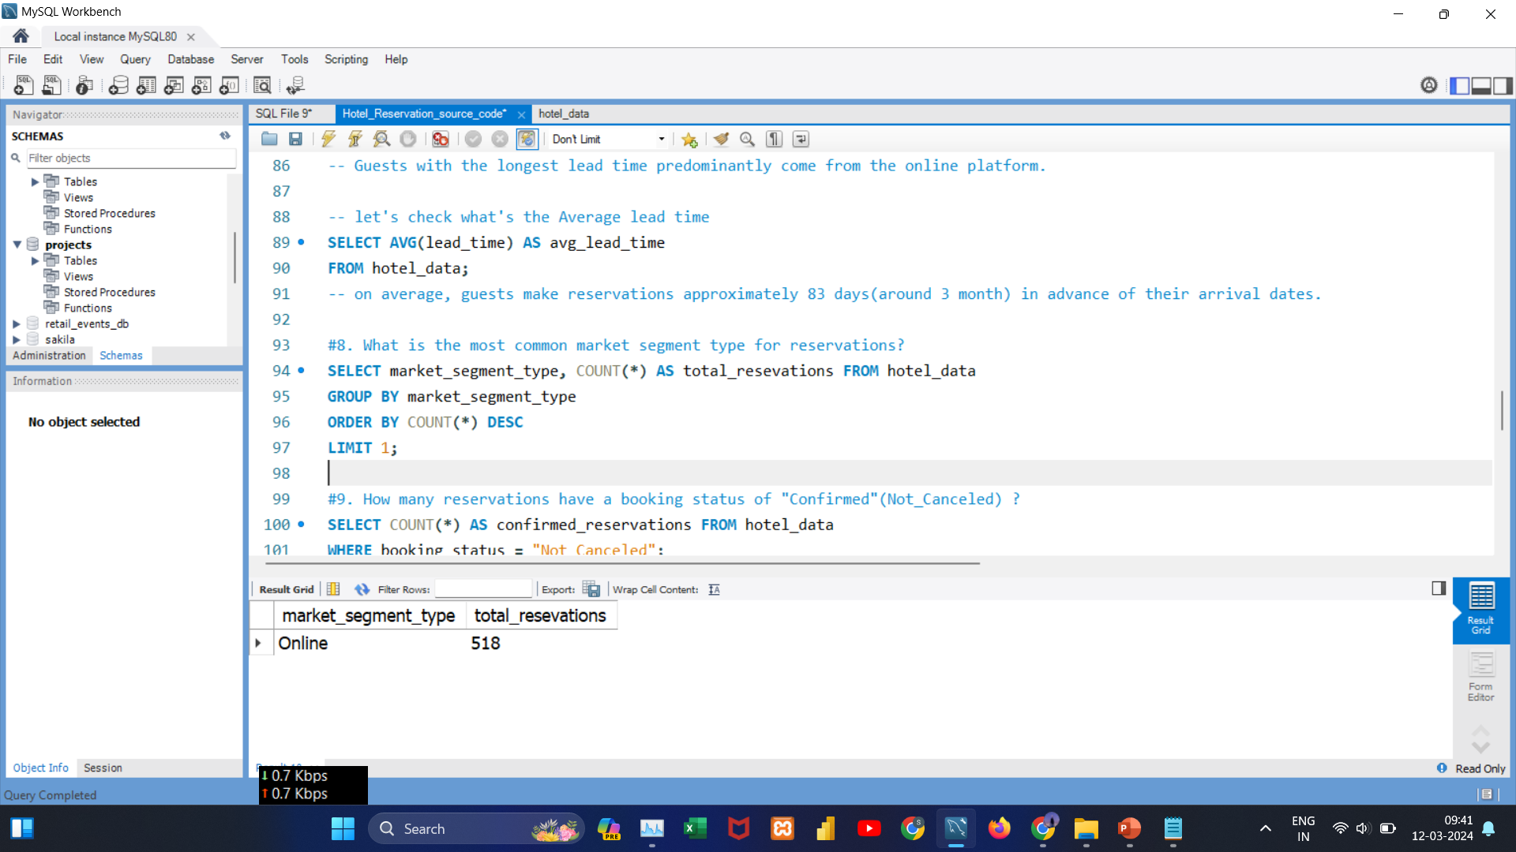
Data Analysis Queries
#Query9:
What is the most common market segment type for reservations?
Insights:
The online market segment is the most popular choice among guests , showcasing a clear preference for online reservations.

Slide 14
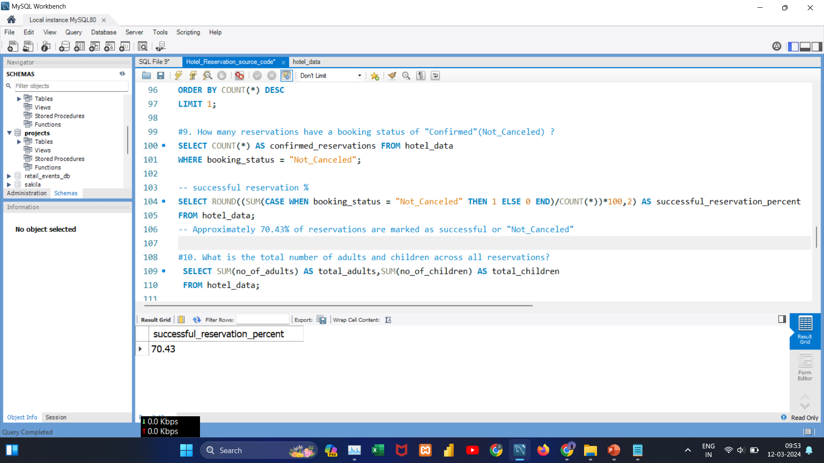

Data Analysis Queries
#Query10:
What is the total number of confirmed reservations, and what percentage of reservations have a "Confirmed" booking status?
Insights:
Out of 700 reservations, 493 are confirmed, indicating a success rate of approximately 70.43%. This suggests a high rate of successful reservations.

Slide 15
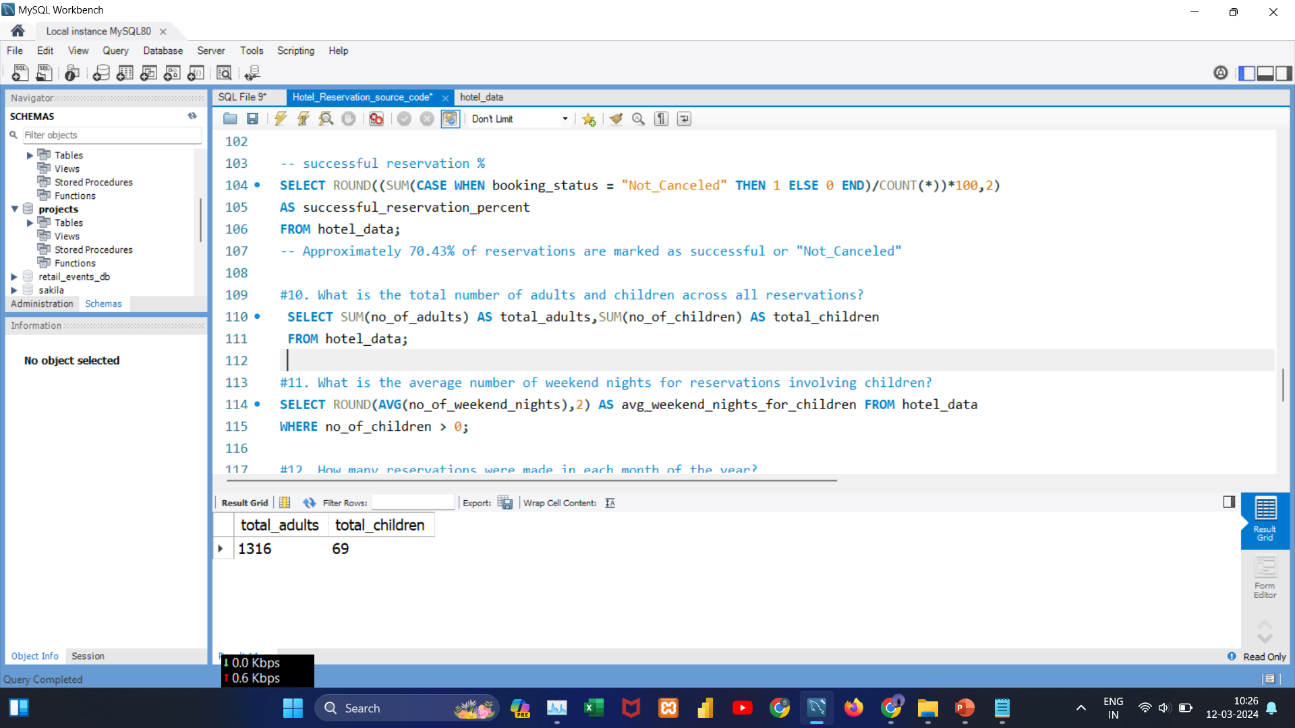
Data Analysis Queries
#Query11:
What is the total number of adults and children across all reservations?
Insights:
The majority of reservations, totaling 1,316, involve adult guests, while a smaller number, 69, include children. This highlights the hotel's primary appeal to adult.

Slide 16
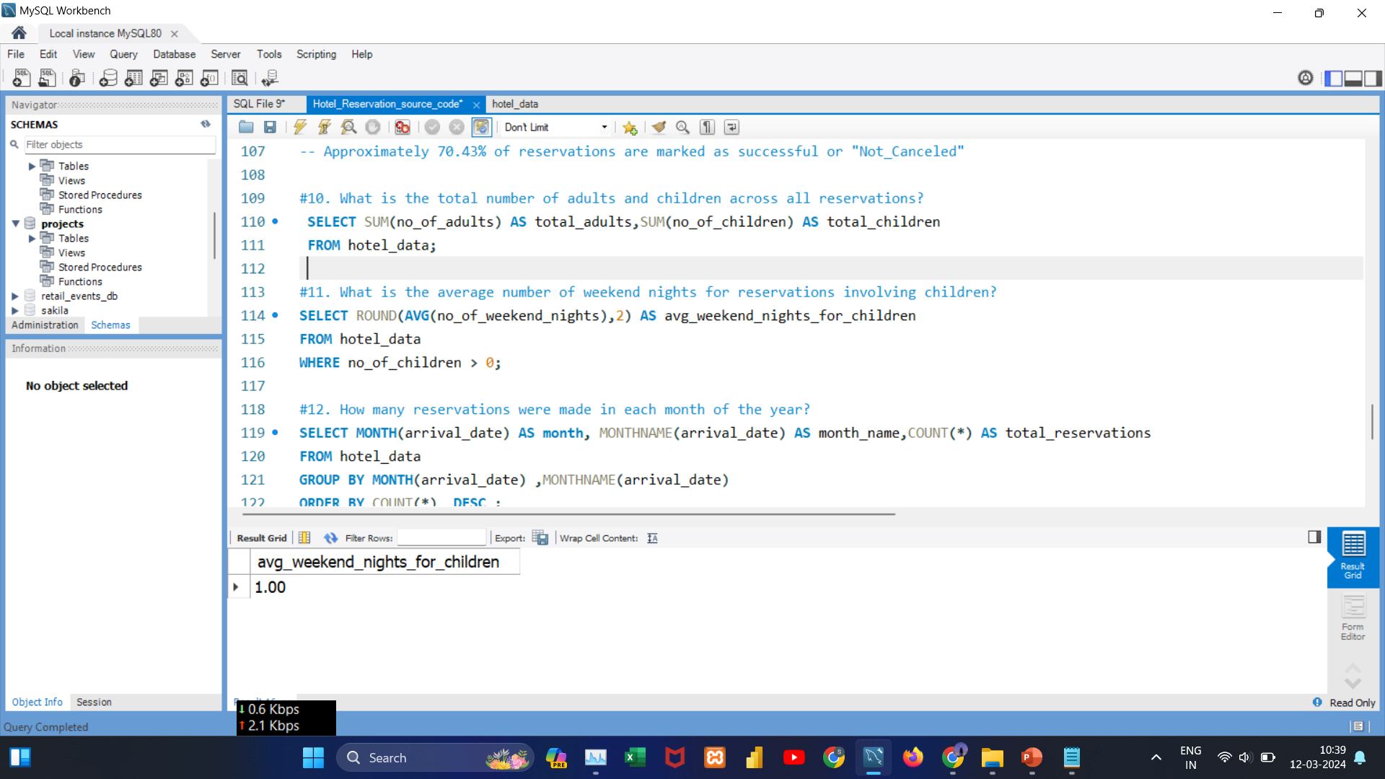
Data Analysis Queries
#Query12:
What is the average number of weekend nights for reservations involving children?
Insights:
On average, reservations with children involve a one-night stay on weekends, highlighting a preference for weekend stays, particularly suitable for families.

Slide 17
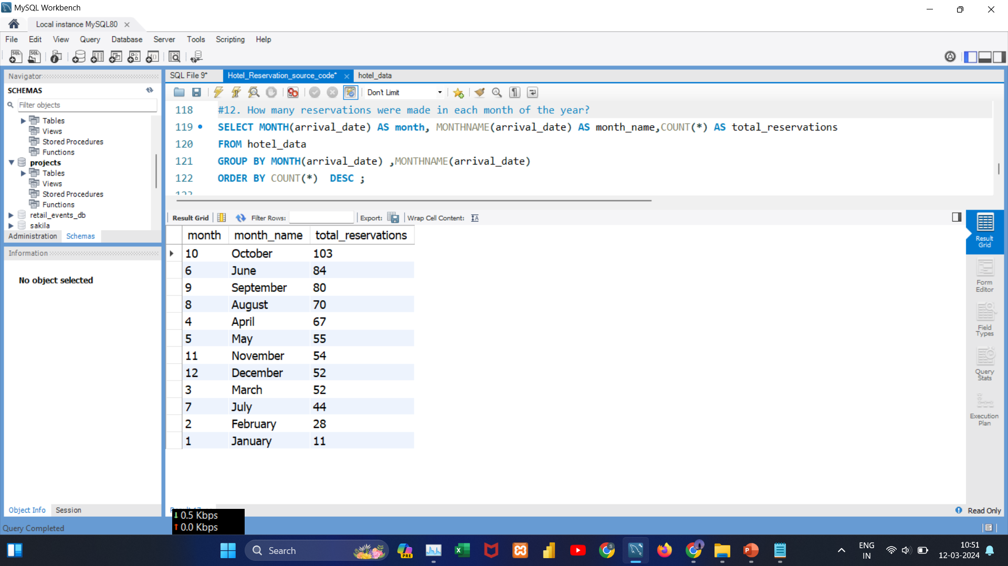
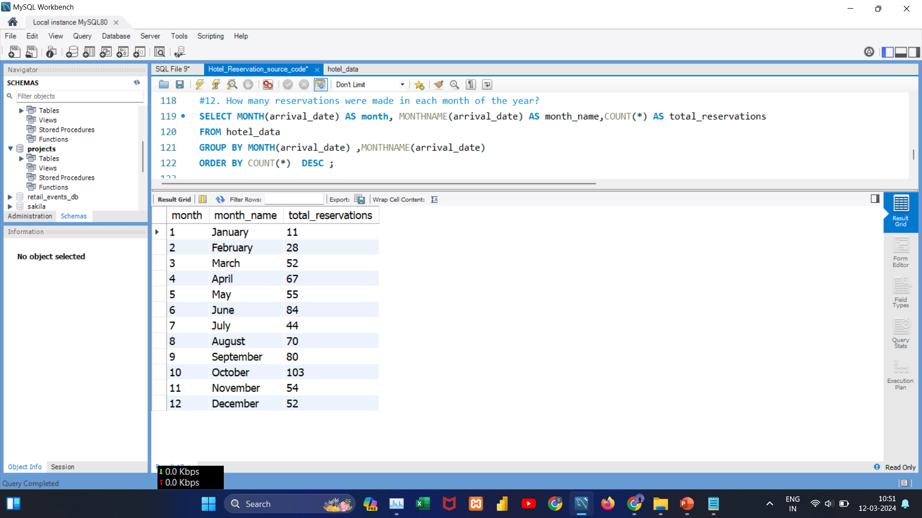
Data Analysis Queries
#Query13:
How many reservations were made in each month of the year?
Insights:
October stands out as the peak reservation month followed by June and September .
In contrast, January records the lowest number of reservations, indicating a quieter period.

Slide 18
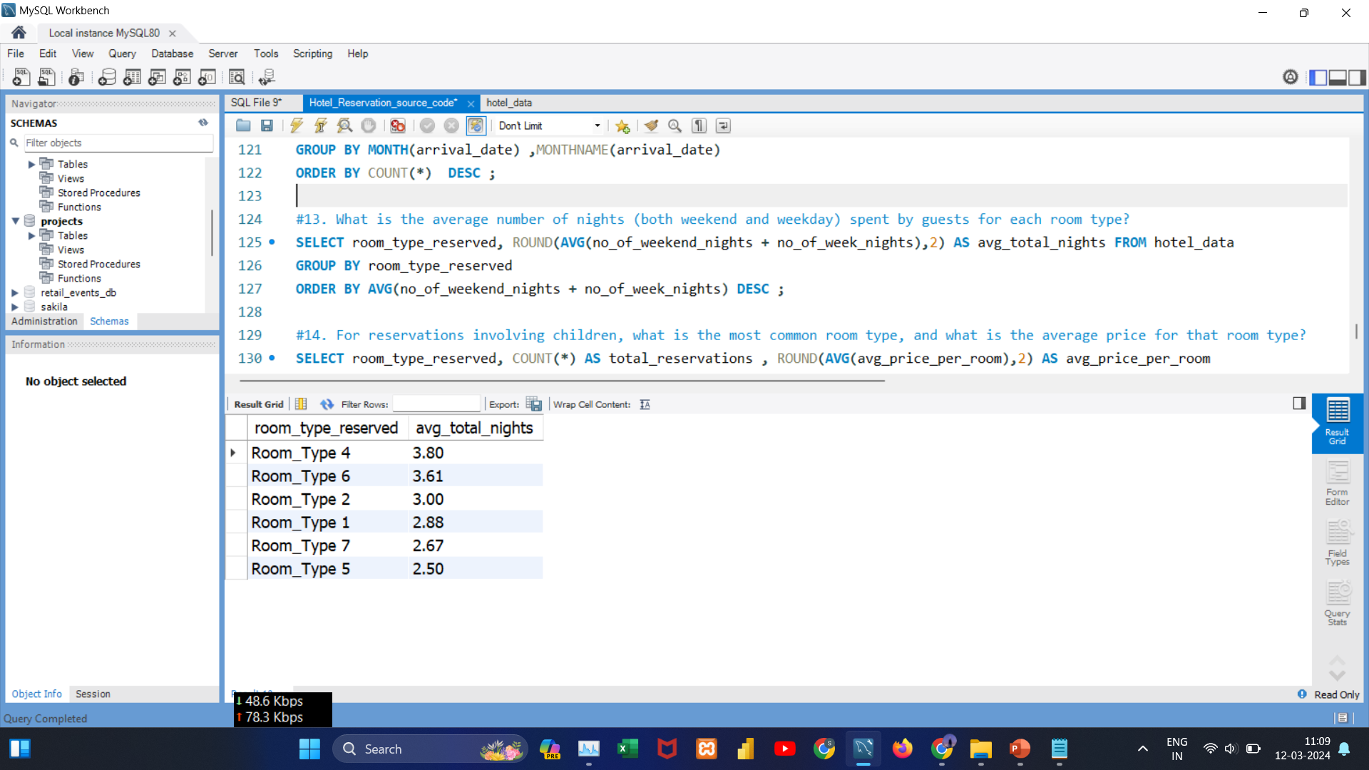
Data Analysis Queries
#Query14:
What is the average number of nights (both weekend and weekday) spent by guests for each room type?
Insights:
Guests staying in Room Type 4 tend to spend the most nights on average (3.80), while those in Room Type 5 have the lowest average stay duration (2.50).

Slide 19
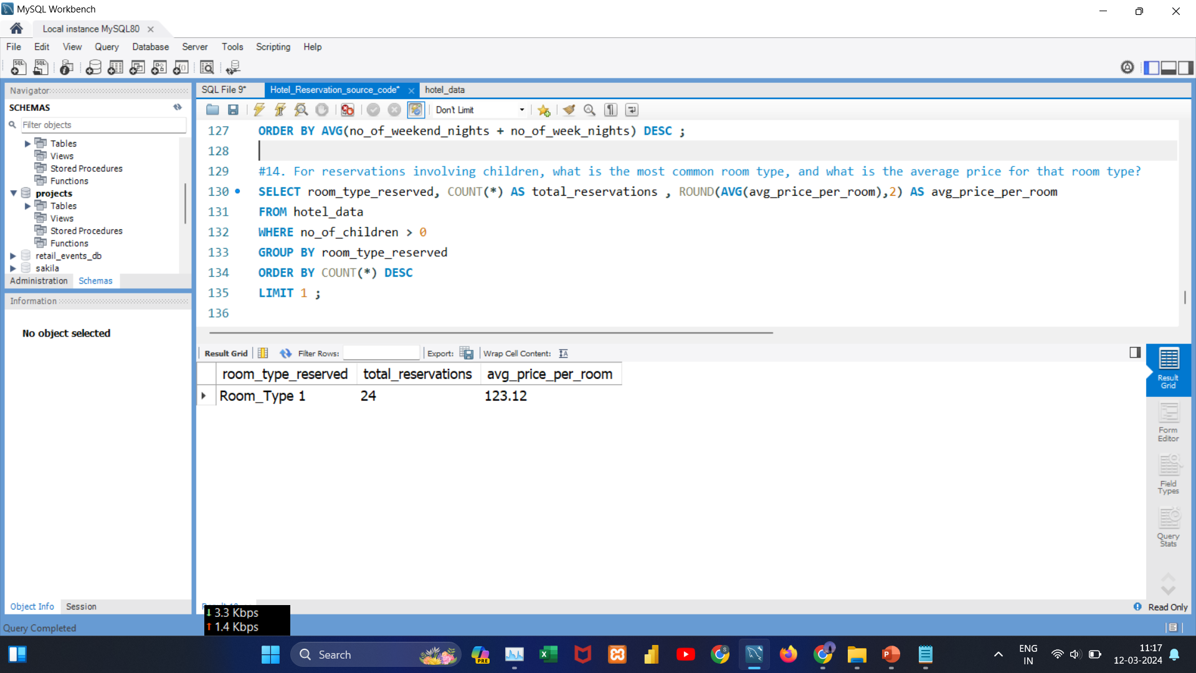
Data Analysis Queries
#Query15:
For reservations involving children, what is the most common room type, and what is the average price for that room type?
Insights:
For reservations involving children, Room Type 1 is the preferred choice, with an average room price of 123.12.

Slide 20
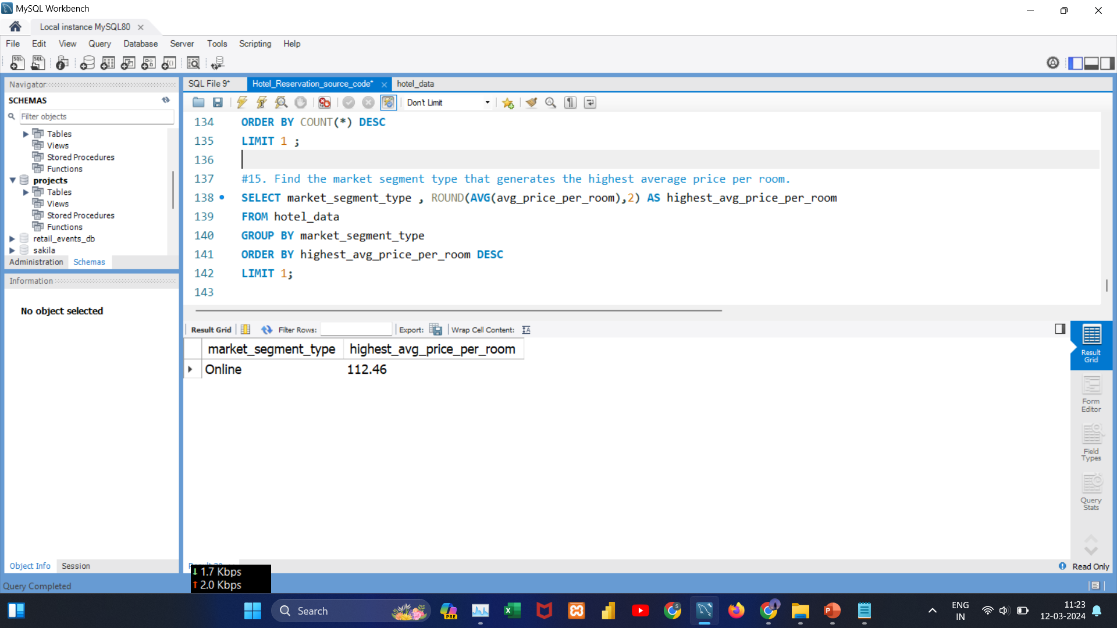
Data Analysis Queries
#Query16:
Find the market segment type that generates the highest average price per room?
Insights:
Online bookings generate the highest average room price, reaching 112.46.

Slide 21
Key Questions
What is the total number of reservations in the dataset?
Which meal plan is the most popular among guests?
What is the average price per room for reservations involving children?
How many reservations were made in each year?
What is the most commonly booked room type?
How many reservations fall on a weekend (no_of_weekend_nights > 0)?
What is the highest, lowest, and average lead time for reservations?
What is the distribution of market segments for guests making same-day reservations versus those with long lead times (443 days)?
What is the most common market segment type for reservations?
What is the total number of confirmed reservations, and what percentage of reservations have a "Confirmed" booking status?
What is the total number of adults and children across all reservations?
What is the average number of weekend nights for reservations involving children?
How many reservations were made in each month of the year?
What is the average number of nights (both weekend and weekday) spent by guests for each room type?
For reservations involving children, what is the most common room type, and what is the average price for that room type?
Find the market segment type that generates the highest average price per room?

Slide 22
Overall Insight
The dataset comprises 700 bookings.
Meal Plan 1 is the top pick among guests.
Bookings that include children have a mean room cost of 144.6.
The number of reservations rose significantly from 123 in 2017 to a higher figure in 2018.
Room Type 1 is the most frequently booked.
Mostly guests (656) opt for weekday stays than weekend stays (383).
Booking behaviors vary, with lead times from 0 to 443 days.
On average, bookings are made about 83 days (roughly 3 months) prior to arrival.
Immediate bookings (arrivals on the same day) are predominantly made by guests from online, corporate, and offline segments.
The online segment is the most frequently used for bookings.
Out of 700 bookings, 493 are confirmed, yielding a success rate of approximately 70.43%.
The majority of bookings (1,316) which are made by adults.
Bookings that include children typically involve one-night stays over the weekend.
October is the busiest month for bookings, while January has the fewest.
For bookings that include children, Room Type 1 is the top choice, with an average room cost of 123.12.
Online bookings yield the highest average room cost, at 112.46.

Slide 23


